Slide 1
Cosmic ray measurements using such detectors in huge physical experiments as LHC or NICA
WARNEŁŁO KAMIL
Jagiellonian University in Cracow, Cracow, Poland
NECȘOIU ILIE-ANDREI
University of Bucharest,Bucharest, Romania
CORDUN CRISTINA-MARIA
University of Bucharest,Bucharest, Romania
HĂRDUȚ ALEXANDRA-NARCISA
Babes-Bolyai University, Cluj Napoca, Romania
FILIP ROBIN
Brno University of Technology, Brno, Czech Republic
Supervisor:
M. Bielewicz Ph.D.

Slide 2
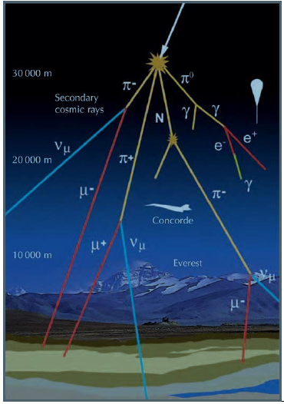
INTRODUCTION
A cosmic ray is a high-speed particles that travels throughout the Universe.
There are two types of cosmic rays: primary and secondary.
Primary radiation:
90% protons
9% alpha particles
~1% electrons
other havier nuclei
Secondary radiation:
muons
pions
neutrinos
electrons
gamma rays

Slide 3
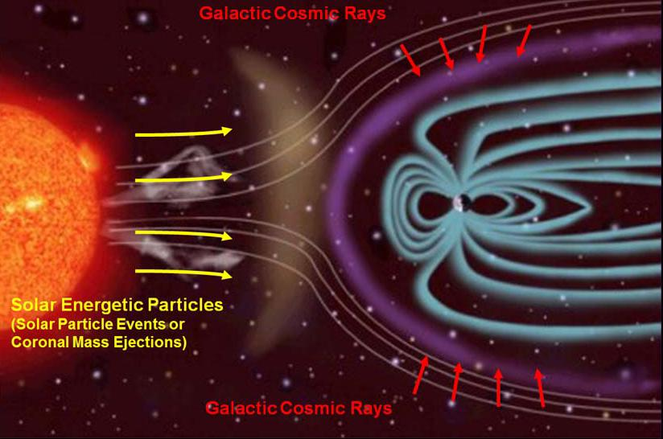
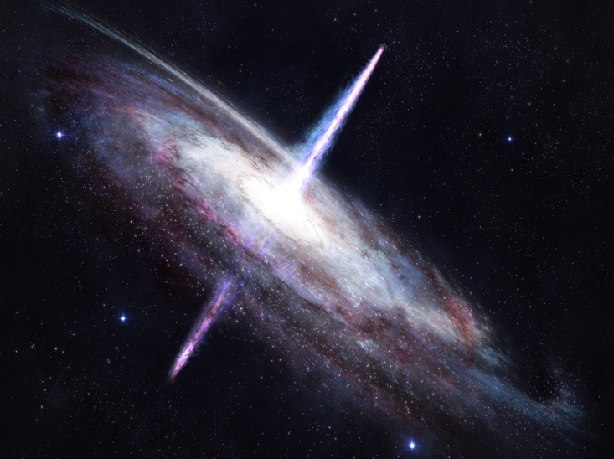
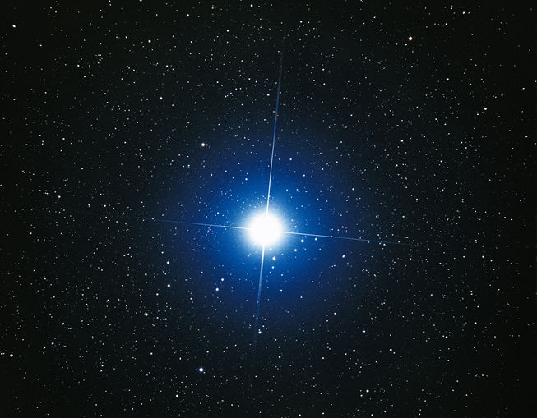
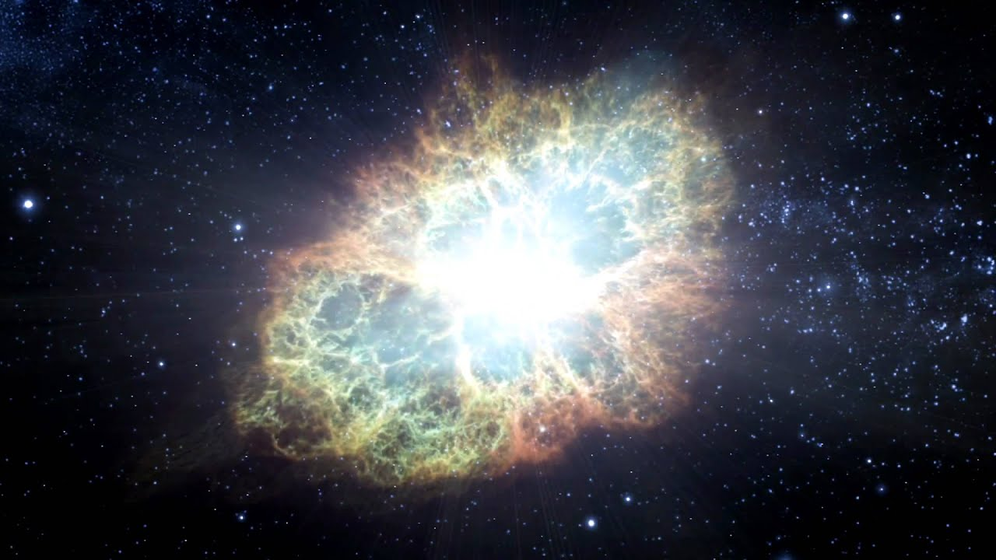
SOURCES
The Sun
Other stars
Supernova
Active galactic nuclei (black holes, quasars)

Slide 4
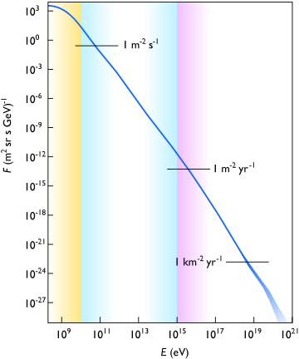
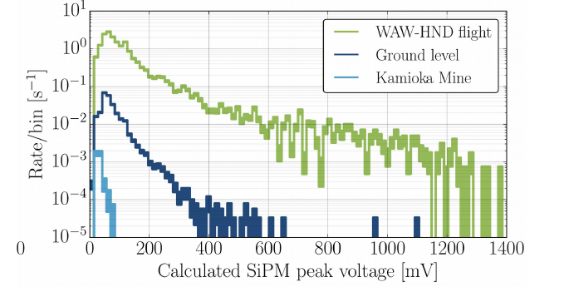
There can be detected more low energy particles than high energy ones.
The flux depends on:
Altitude of the measurement;
Angle of measurement.

Slide 5
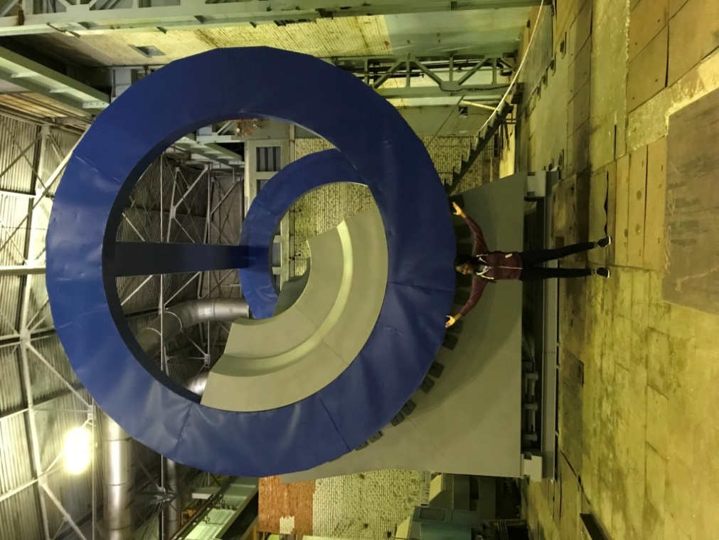
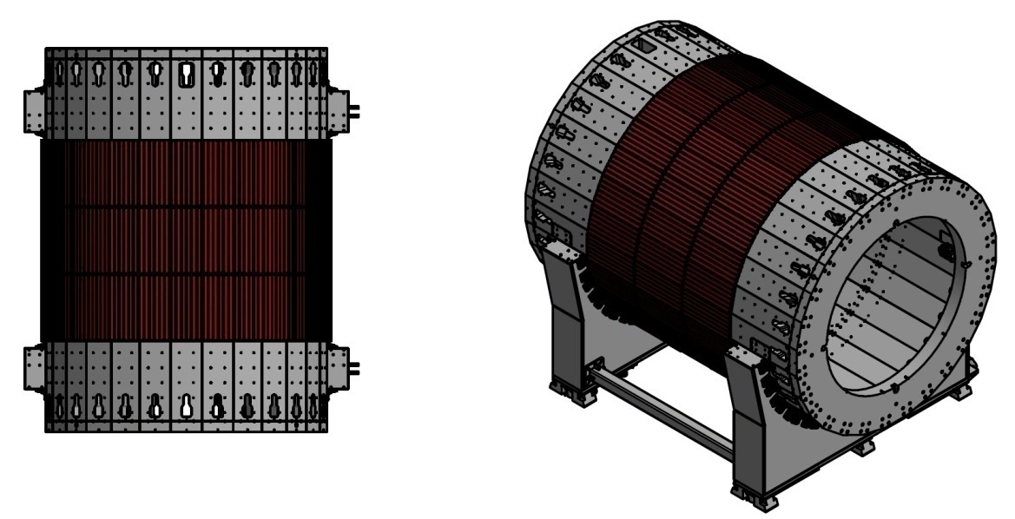
Motivation - MPD
MPD uses cosmic rays detector for isolating inner particles from outside (mainly muons).
Verification of simulations, calibration of the detector.
Notes:
MPD = Multi purpose detector
Only muons cause the other particles will be stopped by the surroundings(walls etc).

Slide 6
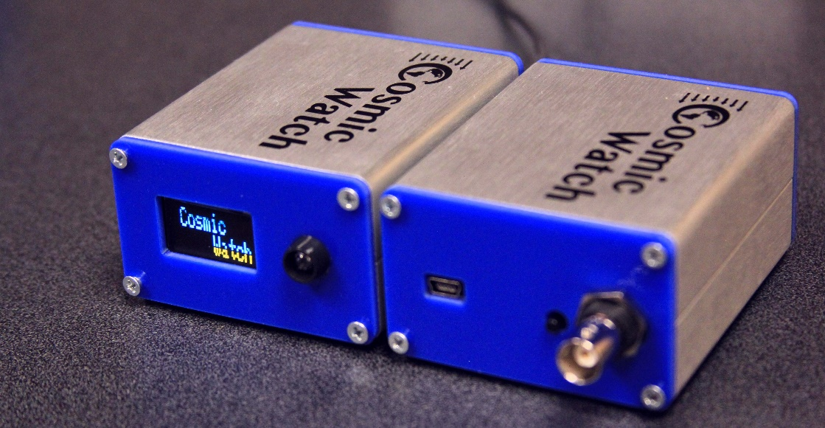
Cosmic Watch
Cosmich Watch is simple, physics-motivated machine- and electronics-shop project for university students and schools.
These detectors can be battery powered and used in conjunction with the provided software to make interesting physics measurements.

Slide 7
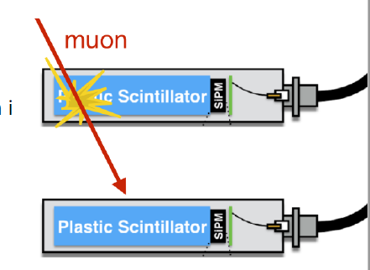
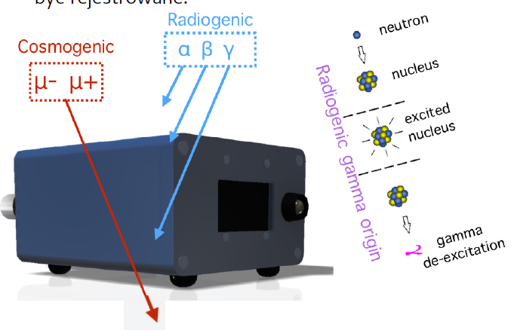
Principle of detection
The muons deposit 1-3 MeV per cm of scintilator.
The measured voltage depends on the angle of the muon entering the scintilator
The detectors work on coincidence mode.

Slide 8
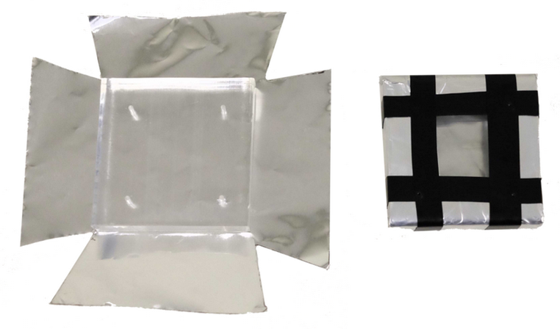
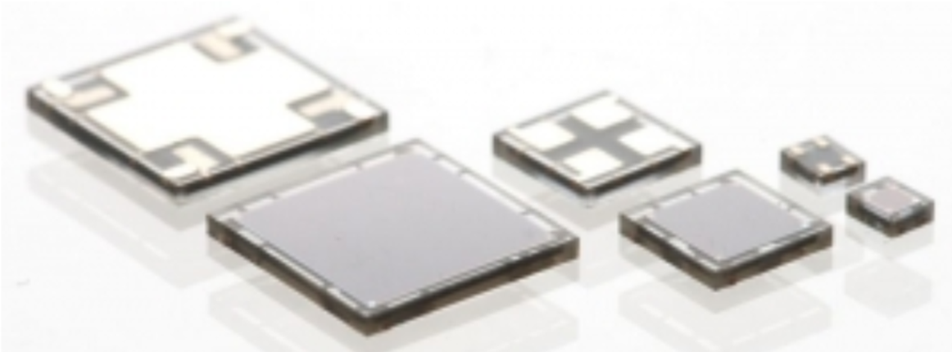
Scintillator and SiPM
A scintillator is a material that exhibits scintillation, the property of luminescence, when excited by ionizing radiation.
Silicon photomultipliers, often called "SiPM" in the literature, are solid-state single-photon-sensitive devices.

Slide 9
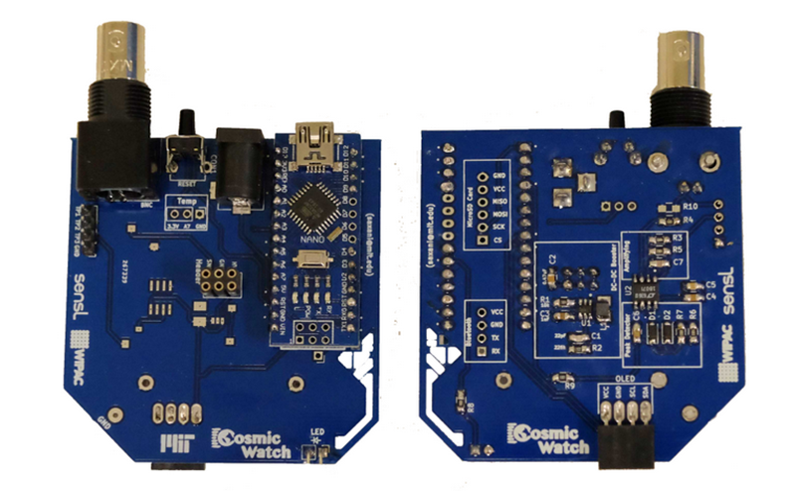
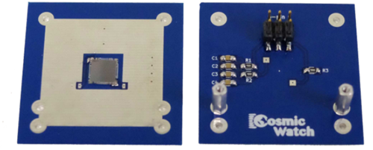
PCB
There are two PCBs which must be populated. The smaller PCB holds the SiPM and some filtering electronics for biasing the SiPM. The larger of the two is the main PCB (shown in the picture above) and contains the data acquisition electronics.
After the main PCB is populated, we can move to the SiPM PCB.

Slide 10
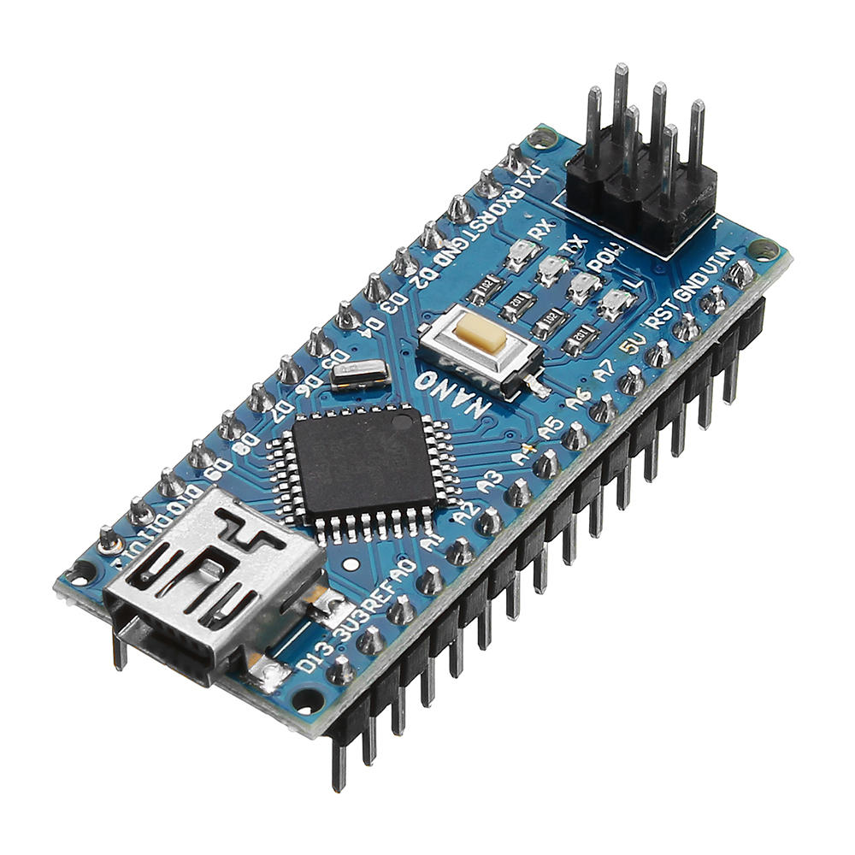
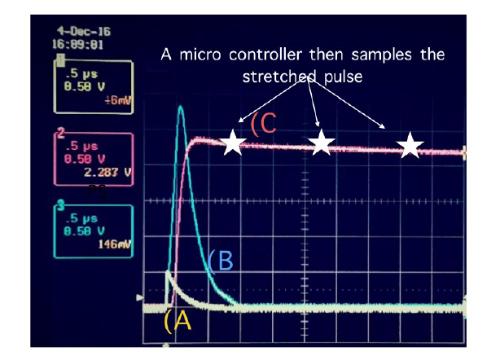
Arduino
The Arduino is used to perform several tasks:
Set the trigger threshold on the ADC.
Measure the pulse amplitude from the peak detector circuit.
Convert the SiPM analog signal to digital signal.
Record the time of the event and dead time between events.
Control the OLED screen and LED light.
Send the data through USB to a computer.

Slide 12
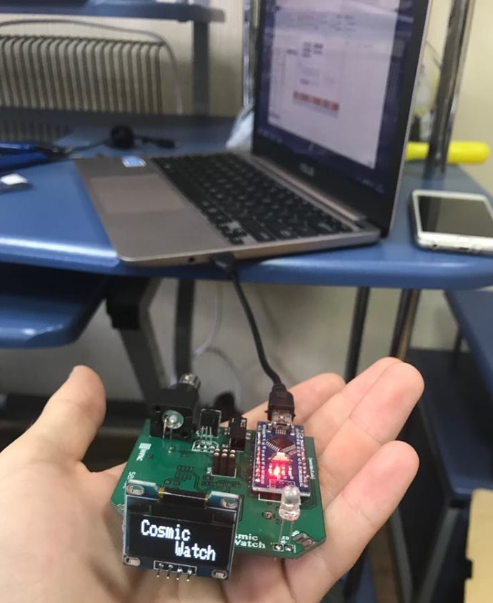
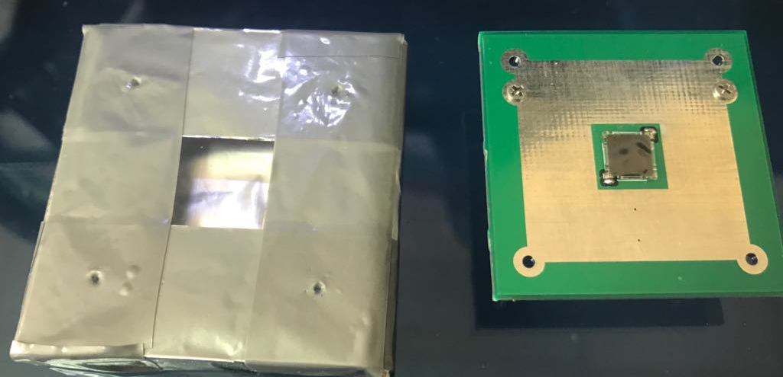
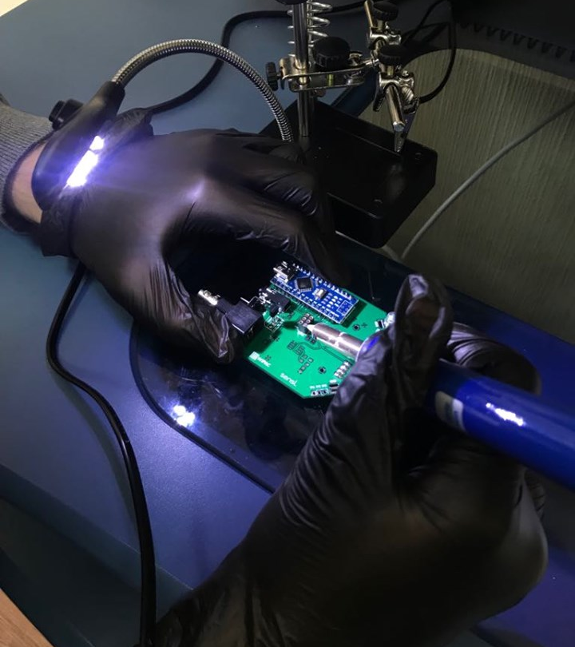
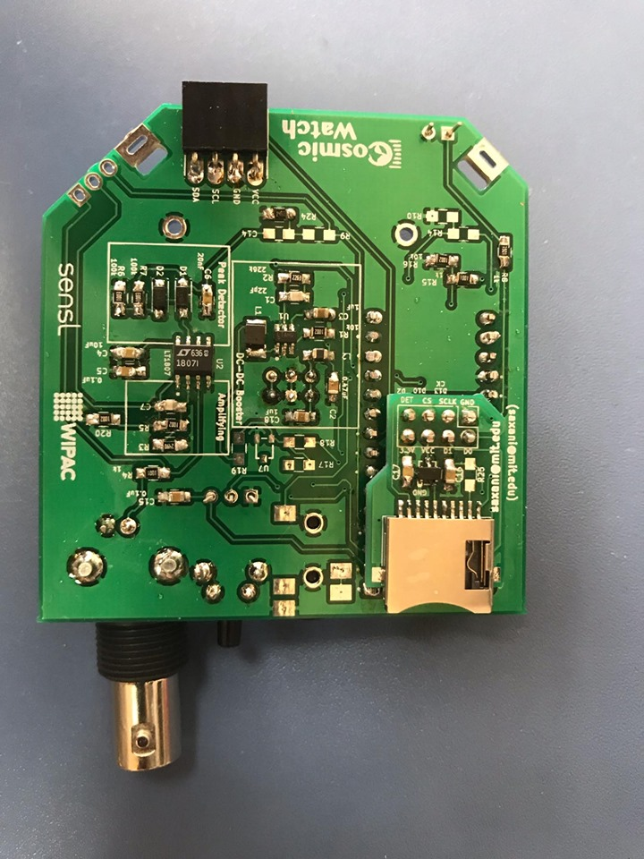

Slide 13
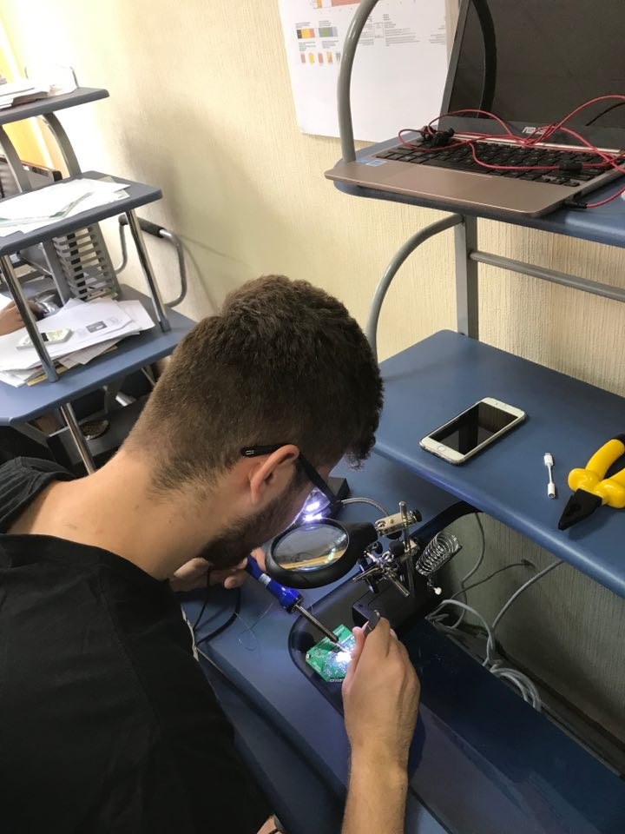
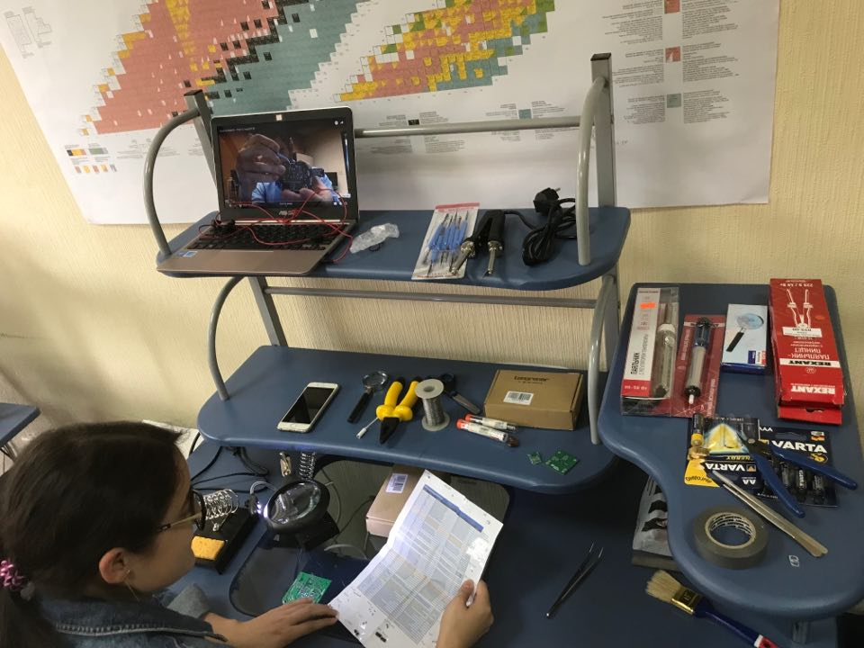

Slide 14
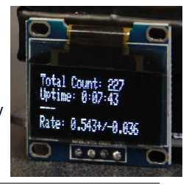
Software
Working mode:
OLED
SD Card
Softwares:
Arduino (obtain the data)
Python (analyze the data)

Slide 15
It can work in 2 ways:
Individually (Master)
Coincidence mode (Master and Slave)
There can be many detectors working at the same time

Slide 16
The coincidence mode
M
S

Slide 17
Measuring and results
3 types of measurement:
Distance dependence
Impact of the shielding
Angle dependence

Slide 18
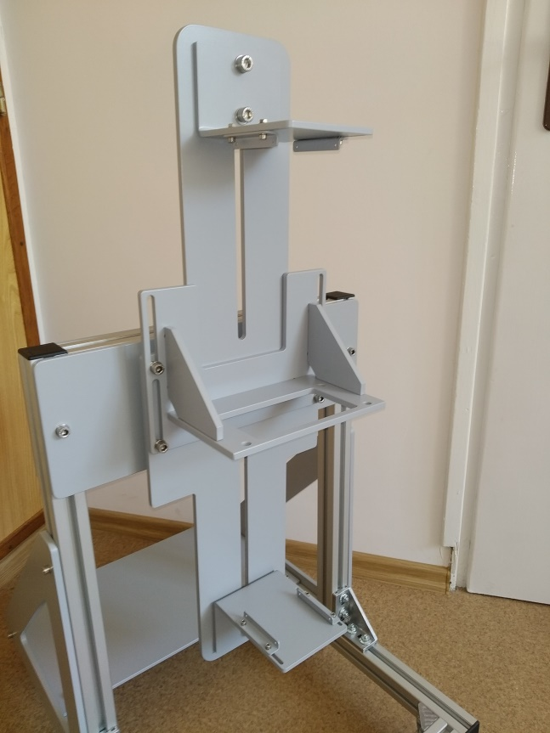
Distance dependence
The relation between the number of detected particles to the size of the observed sky.
Distance: 10cm - 40cm, 5cm step.
The flux[cm⁻²s⁻¹sr⁻¹] should be constant.
The flux[cm⁻²s⁻¹] should exponentially drop.

Slide 19
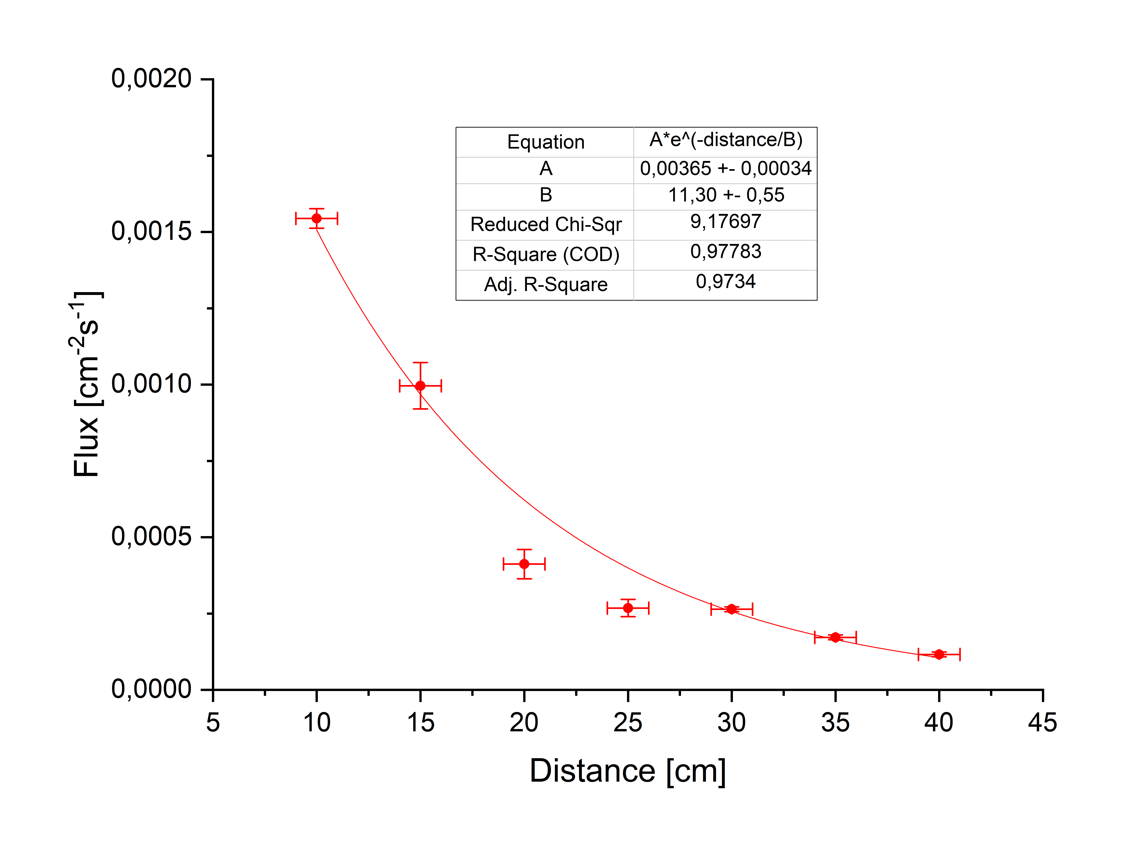
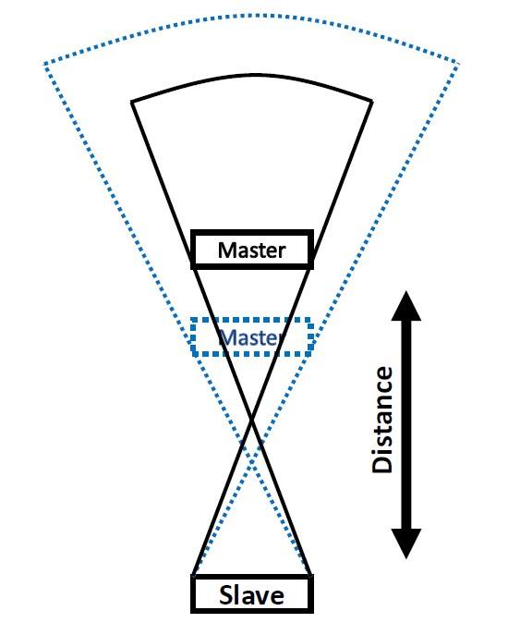
Errors:
Distance measurement
Naturally fluctuation of the flux
Statistical error
It decreases exponentially

Slide 20
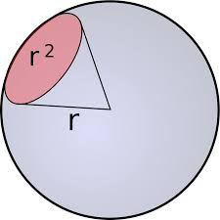
Steradians ∈ (0, 4π]
In geometry, a solid angle (symbol: Ω) is a measure of the amount of the field of view from some particular point that a given object covers.
The formula for a point and a rectangle:
l
b
l = b = 5cm
d = D/2
D
The final formula is:
$ω=4\sin^{−1}{(\frac{l^{2}}{l^{2}+D^{2}}}$)
l
http://www.mpia.de/~mathar/public/mathar20051002.pdf

Slide 21
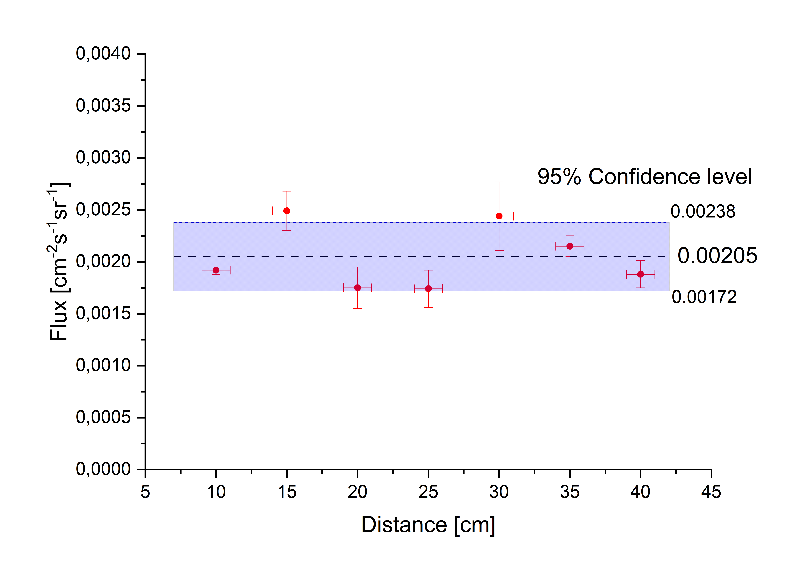
The flux including steradian is approximately constant no matter the distance between the detectors
$${C.L.}_{95\%}=1.96 \frac{\sum_{n}{y_{n,err}}}{n}$$

Slide 22
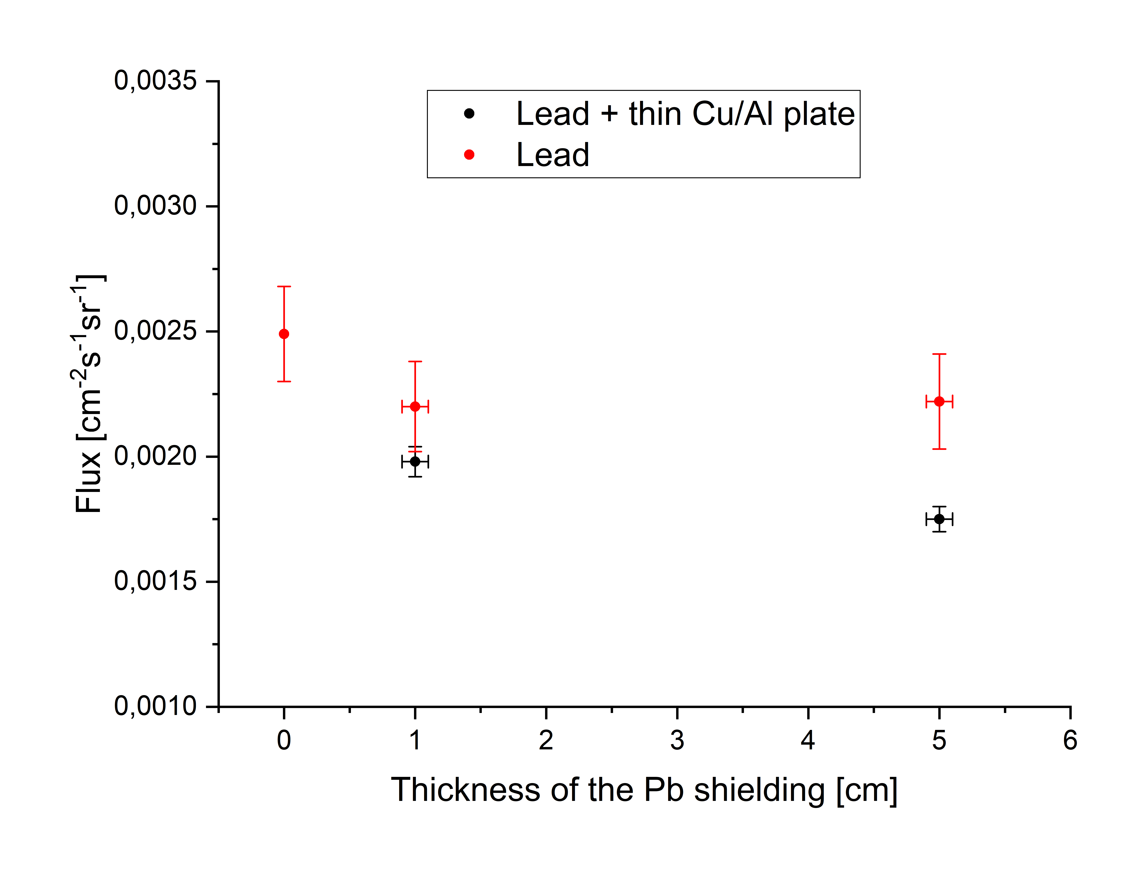
Impact of the shielding
Errors:
Pb thickness measurement
Naturally fluctuation of the flux
Statistical error

Slide 23
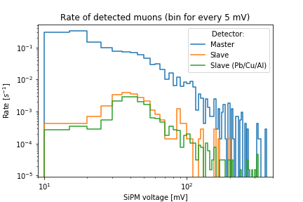
Energetic spectrum of the flux

Slide 24
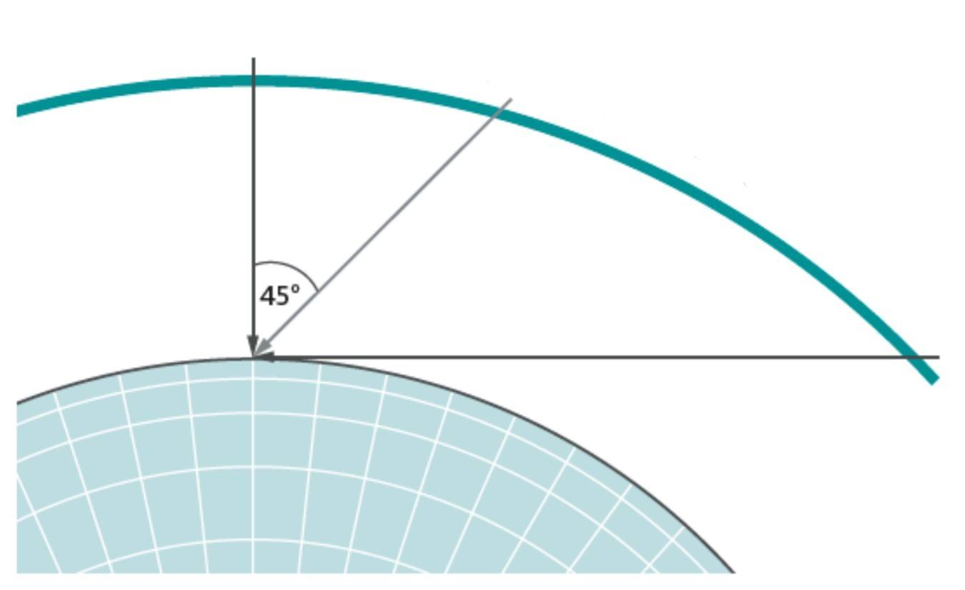
Angle dependence
a
b
b>a
The relation between the number of detected particles to the horizontal angle.
Inside and outside measuring

Slide 25
CORSIKA Simulation
Fitting function: $A{(cos{ϴ})}^{2}$
A – flux for 0ᵒ
Errors:
Angle measurement
Naturally fluctuation of the flux
Statistical error

Slide 26
Conclusions
Cosmic watch is cheap, simple and easy to use device for detection of muons.
The number of detected particles drops exponentially with increasing the distance between detectors.
No significant rate decrease with up to 5 cm of Pb shielding. Additional thin Cu and Al plates improves the effect of the shielding.
Both inside and outside measurements could be fitted using Acos²ϴ, in-line to the theory.
The flux that we measured outside was bigger than the one we measured inside, but the shape of the curve remained the same, like we expected.

Slide 27
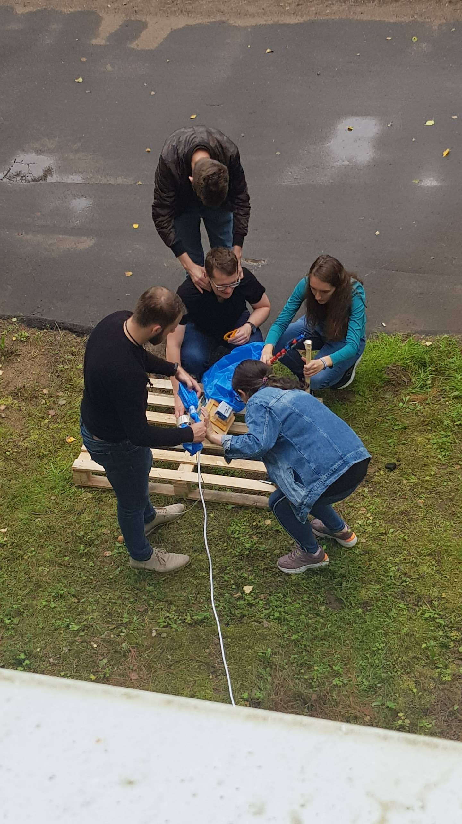
Thank you for your attention! ☺
MASTER
SLAVES

Slide 28
References
Project COSMIC WATCH, Katarzyna Frankiewicz, Seminarium Departamentu Eksploatacji Obiektów Jądrowych, 10/1/2018
http://cosmicwatch.lns.mit.edu/about
Strugalski Z. Promieniowanie kosmiczne Oficyna Wydawnicza Politechniki Warszawskiej, Warszawa, 1993
M. Tanabashi et al. (Particle Data Group), Phys. Rev. D 98, 030001 (2018), p.6
https://www.youtube.com/channel/UCmpJLRWiLiNxXXkBIefrD9Q

